Slide 1
Car Sharing Analytics
Danilo Giordano - danilo.giordano@polito.it
Indaco Biazzo – indaco.biazzo@polito.it

Slide 2
SmartData@PoliTo
Inter-departement center
https://smartdata.polito.it

Slide 3

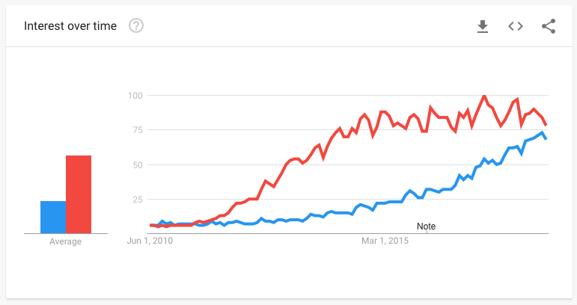
Big Data & Data Science
“Extracting meaning from very large quantities of data”

Slide 4

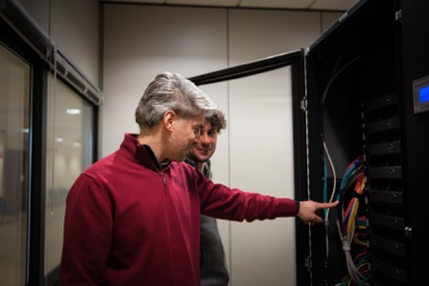


GOAL of SmartData@PoliTO
Born on the experiences and competencies
EE – Internet monitoring
CS – Data mining & machine learning
MAT – Statistics and modelling
Phy – Modelling and inverse problems
MNG – Economics and business impact
…
And on the BigData@PoliTO centre
Fully dedicated Cluster hardware
Offer access and support for these technologies
Technology transfer: toward industries

Slide 5

SmartData@PoliTO in one slide
Information
Complete Name SmartData@PoliTO
Parent organization Politecnico di Torino
Sponsors Both Private and public
Location Torino
Born in 2017
Website smartdata.polito.it
Coordinator Marco Mellia
Address Corso Duca degli Abruzzi 24 - 10129 Torino
Contacts contact.smartdata@polito.it
Data updated May 2018
7
Industrial Project private [2017]
Focus:
AI
ML
IoT BIG DATA INDUSTRY 4.0
1
Cluster
2.5TB RAM,
324 Cores,
773TB
30+
Professors
3Mln€/y
Funding [2017]
1
Large project [2017]
15+
PhD Students

Slide 6

Competences
Algorithms and methodologies for data analysis
Big data processing, data mining, supervised and unsupervised machine learning, deep learning, rule mining, classification, prediction, anomaly detection, clustering, …
Methodologies for data modeling
Statistics, computational topology, geometry with application to data analysis, graph modeling and information mining from graphs, …
Study the transformations in industrial structures
Value chains, business models, managerial practices, …
Generation
Acquisition
Storage
Analysis

Slide 7
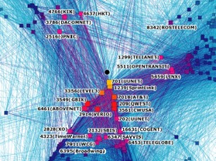
Applications and domains
Predictive maintenance for complex systems
Anomaly detection with applications to time series analysis
Cybersecurity
Mobility in smart cities
Data diffusion in complex systems

Slide 8
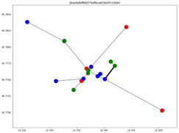
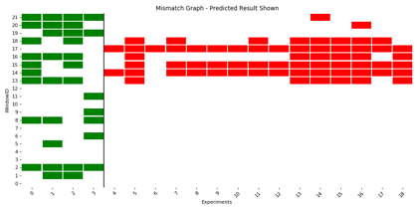
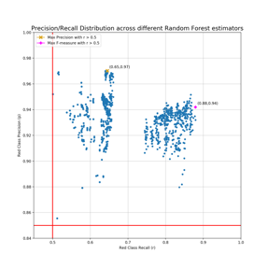
Collaboration with Private Companies
ENEL
Predictive Maintenance
Analysis of data from electric grid (SCADA) to predict failures/malfunctioning of vital elements
Advanced Diagnostic/Predictive Maintenance
Analysis of data from powertrain systems to predict failures/malfunctioning

Slide 9

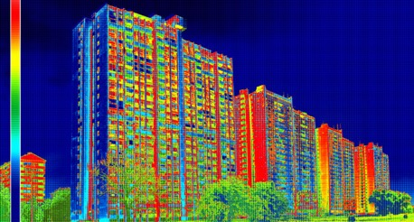
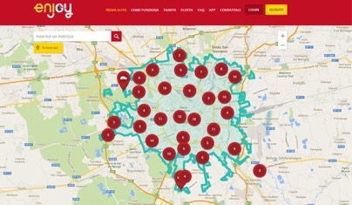
Collaboration with Private Companies
EDISON
Smart City
Harvesting of open data for the characterization of energy consumption of residential and commercial buildings
Mobility prediction
Study of traffic patterns from car sharing systems
Design of electric car sharing system

Slide 10

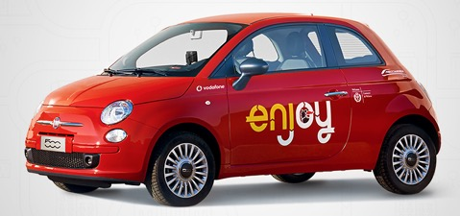
Can we use car sharing data to…
… Understand user behavior?
… Improve system design?
… study novel solutions?
For example:
In a future electric car sharing system, where the user is not force to plug the car all the time, how shall I place the charging station?

Slide 11
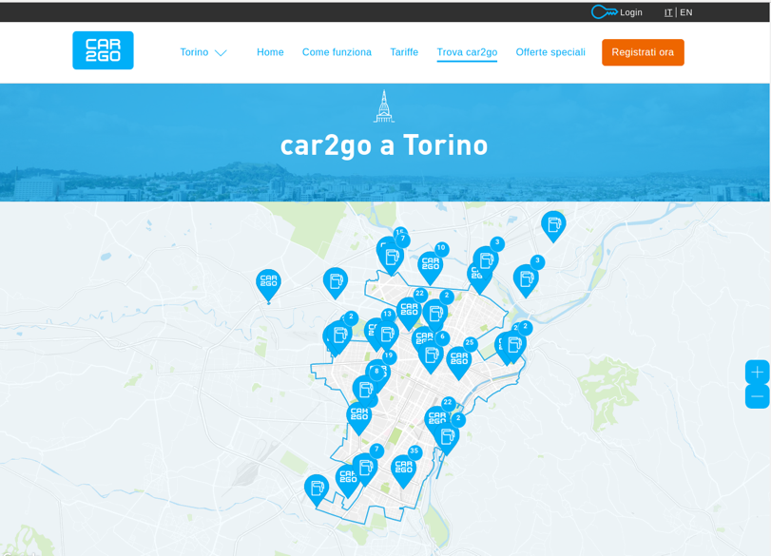
Car Sharing
Free Floating Car Sharing (FFCS) system
Users can pick and drop a car wherever in a geo-fence area
Car2go and enjoy
… How do we get car sharing data?

Slide 12






Data Collation and Processing
3 stage framework
Data Collection: Collect data from different FFCS providers
Data Normalization and Storage: Process the collected data to normalize it in a common format and save it in a Data Lake
Data Analysis: Analyze the data to extract meaningful information
Rental Duration
Data Normalization
Route length
Driving Habits
Parking Areas
Data Lake
Users’ Habits
Others
1st Stage
Data collection
2nd Stage
Data Normalization and Storage
3rd Stage
Data Analysis

Slide 13
1st Stage: Data Collection
2 Crawlers fetch data from 2 FFCS providers
Every minute we get a new snapshot of available cars
car2go
Public API available until January 2018¹
Based on a shared key in the URL
Download list of available cars in a specific city as a JSON document
The city is directly specified in the URL
Enjoy
NO API available
Use cookies to create a session and download the data
Download list of available cars in a specific city as a JSON document
The city is specified in the cookies
JSON document
List of available car plus for each car several information
¹: https://github.com/car2go/openAPI

Slide 14
Example of a JSON document
{
“Plate" : "292/EZ727ZW",
"Vin" : "WME4513341K725150",
"Coordinates" : [7.68461, 45.05523],
"Fuel" : 100,
"Address" : "Corso Massimo d'Azeglio 26, 10125 Torino",
…
}

Slide 15
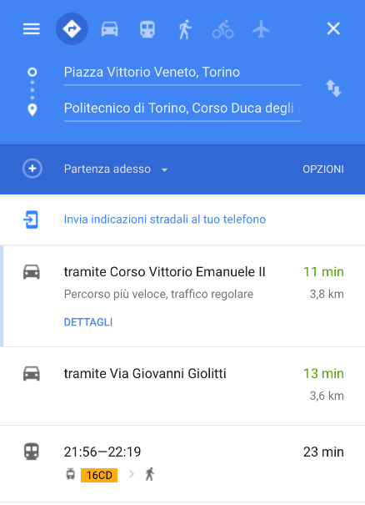
2nd Stage: Data Normalization and Storage
Process the crawler data to extract bookings
The bookings keep information about the bookings of the cars i.e., when a car was (likely) used by a customer
Save Car2go and Enjoy data in a common format
Many information such as: the origin coordinates, the destinations coordinates, the initial time, the final time, the car plate, etc…
Integrate the data with other sources
Use google map API to integrate the data
Given a booking from [x0,y0] to [x1,y1]
When a booking ends, query google maps API for data
Query limitations due to the number of (free) queries
Which was the possible path the driver followed?
Which should be the minimum time to complete journey?
How long would it take to walk instead of driving?
How long would it take by using public transport means?

Slide 16
Caveats
In reality, things are more complicated
Problem: A car may disappear, and reappear in the same place
GPS fix position error
Booking that has been cancelled
System issues?
Solution: Keep bookings longer than 700 m
Problem: Car may disappear for (very) long time
Car brought to maintenance
Solution: Keep bookings lasting less than 1 h
Problem: A lot of car may disappear at the same time
Maintenance?
System issues?
Solution: If more than 30% car disappear do not modify any temporarily booking or parking
Problem: A car may reappear in a different city
Relocation?
System issues?
Solution: Keep bookings shorter than 45 km
Google maps data may be missing
…
Always double check what you get!

Slide 17
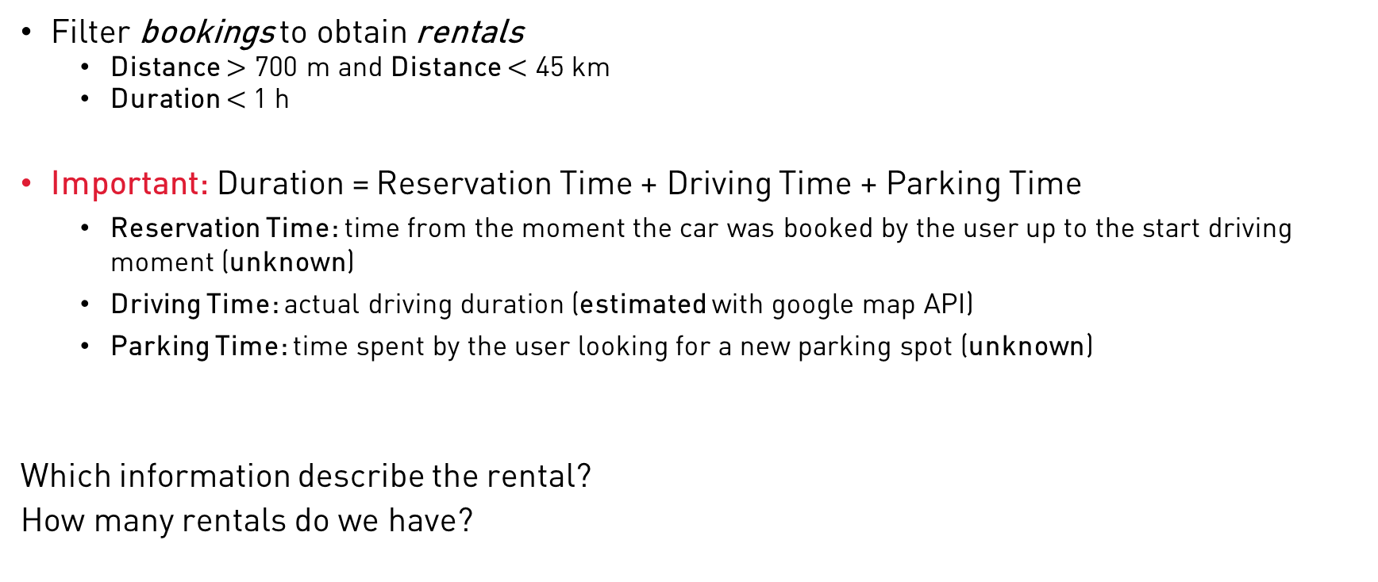
Filtering wrap-up
Filter bookings to obtain rentals
Distance $>$ 700 m and Distance $<$ 45 km
Duration $<$1 h
Important: Duration = Reservation Time + Driving Time + Parking Time
Reservation Time: time from the moment the car was booked by the user up to the start driving moment (unknown)
Driving Time: actual driving duration (estimated with google map API)
Parking Time: time spent by the user looking for a new parking spot (unknown)
Which information describe the rental?
How many rentals do we have?

Slide 18
Dataset
Data is structured in tabular format coded in csv
Each field is divided by ;
Each field is enclosed with “”
Each rental is described by 25 columns
E.g.,
"865775";"enjoy";"Torino";"EZ117GW";"-";"Fiat 500";"1514761298";"2018-01-01 00:01:38";"34";"45.107143";"7.7032084";"45.10154";"7.694324";"1514762999";"2018-01-01 00:29:59";"31";"Corso Giulio Cesare, 299, 10155 Torino TO";"Corso Vercelli, 193, 10155 Torino TO";"940";"1203";"523";"1635";"1514764185";"251";"1220"

Slide 19
Rental Information 1/3
Name | Meaning | Example
id | Unique rental identifier [progressive number] | 1
vendor | Car sharing provider [car2go, enjoy] | Enjoy
city | City of the rental [Torino, Milano, Roma] | Torino
plate | Car unique identifier | EZ117GW
vin | Car unique identifier [only for car2go] | -
car_name | Vehicle manufacturer and model [only for enjoy] | Fiat 500
init_time | Timestamp when the rental started | 1514761298
init_date | Date of when the rental started [from timestamp] | 2018-01-01 00:01:38
init_fuel | Fuel level at the beginning of the rental [in percentage] | 34

Slide 20
Rental Information 2/3
Name | Meaning | Example
origin_lat | Latitude of where the rental started | 45.107143
origin_lon | Longitude of where the rental started | 7.7032084
dest_lat | Latitude of where the rental ended | 45.10154
dest_lon | Longitude of where the rental ended | 7.694324
final_time | Timestamp when the rental ended | 1514762999
final_date | Date of when the rental ended [from timestamp] | 2018-01-01 00:29:59
final_fuel | Fuel level at the end of the rental [in percentage] | 31
init_address | Address of where the rental started | Corso Giulio Cesare, 299, 10155 Torino TO
final_address | Address of where the rental ended | Corso Vercelli, 193, 10155 Torino TO

Slide 21
Rental Information 3/3
Data integrated with Google Maps API
Name | Meaning | Example
walking_duration* | Duration of the trip from the origin to the destination if the user walked [seconds] | 940
walking_distance* | Distance of the trip from the origin to the destination if the user walked [meters] | 1203
pt_duration* | Duration of the trip from the origin to the destination if the user used public transport means [seconds] | 523
pt_distance* | Distance of the trip from the origin to the destination if the user used public transport means [meters] | 1635
pt_arrival* | Timestamp of arrival if the user used the public transport means. Required to correctly estimate duration in night trips | 1514764185
driving_duration* | Duration of the trip from the origin to the destination if the user drove [seconds] | 251
driving_distance* | Distance of the trip from the origin to the destination if the user drove [meters] | 1220
*if no information is available the field is set to -1

Slide 22
Dataset
Rentals per Month
Period | Torino* |  | Milano* |  | Roma
Provider | car2go | Enjoy | car2go | Enjoy | car2go | Enjoy
June 2017 | 50641 | 60047 | 125238 | 159952 | 62384 | 99985
June 2017 | 50136 | 46436 | 125712 | 115933 | 68868 | 57663
January 2018 | 64223 | 48549 | 157578 | 152013 | 74506 | 97004
February 2018 | 0 | 37818 | 0 | 111118 | 0 | 77878
*City for which we have Google Maps information
Fleet size
January Fleet size
Provider | Torino | Milano | Roma
Car2go | 410/470 | 780/820 | 590/610
Enjoy | 260/500 | 920/1480 | 600/1310
Provider | Torino
Car2go | 413
Enjoy | 279

Slide 23
A few results

Slide 24
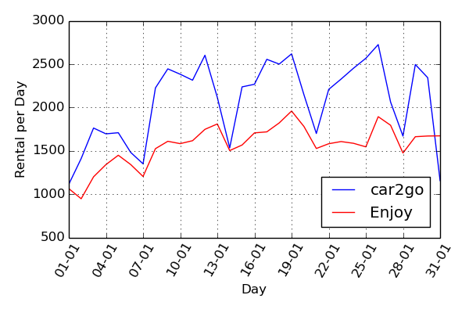
Rental per day
January 2018
Car2go: 413 cars
Enjoy: 279 cars
car2go utilization highly change during the month while Enjoy utilization is more stable
Ca2go utilization drops during the weekend days and festivity
Insight: people may prefer
2 sits car during the weekdays for business reasons
E.g., faster find a parking spot to go to work
4 sits car otherwise

Slide 25
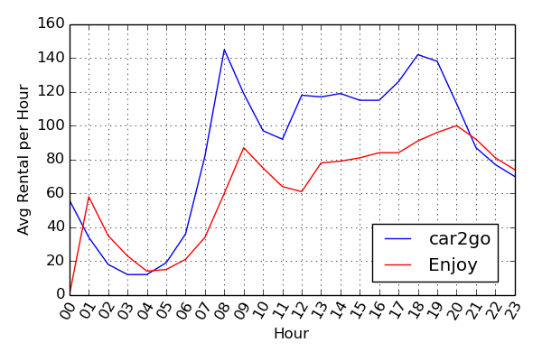
Rental per hour
Each bin of 1 hour is the average number of rentals over the month
Despite Enjoy fleet is smaller, after 8 pm it is more used then car2go
Insight
Car2go is used more during commuting hours
During evening people prefer to share the ride taking a 4 seats model

Slide 26
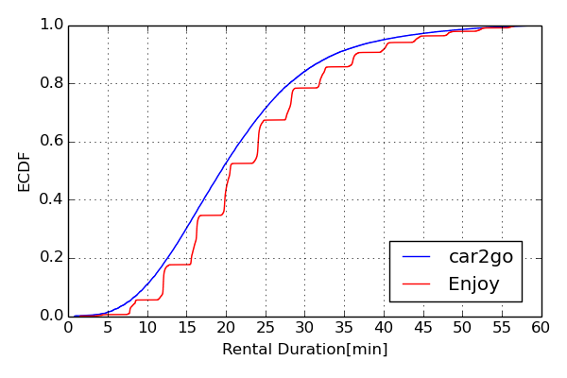
ECDF Rental Duration
Recall: Rental Duration = Reservation Time + Driving Time + Parking Time
Enjoy shows a discrete pattern (steps) due to asynchronous updates
Extra delay at booking end…
Car2go and Enjoy have similar distributions
90% of rentals last less than 40 min
This time includes reservation and parking time
Insight
Most of the customers use FFCS for short trips in duration

Slide 27
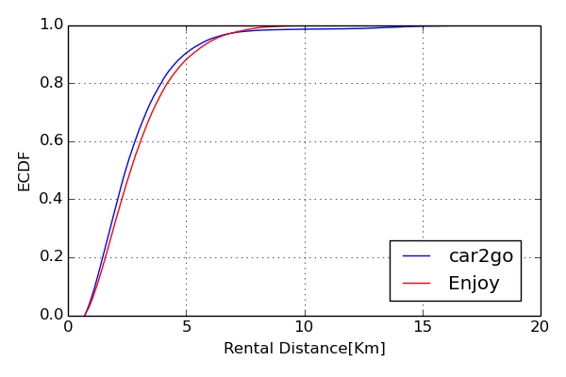
ECDF Rental Distance
The rental distance is computed as the Euclidian distance between origin and destination coordinates
Driving distance is shorted than 5 km 90% of the time
As with Car2go it is possible to reach the airport the maximum rental distance is higher
Insight
Most of the customers use FFCS for short trips in distance as well

Slide 28
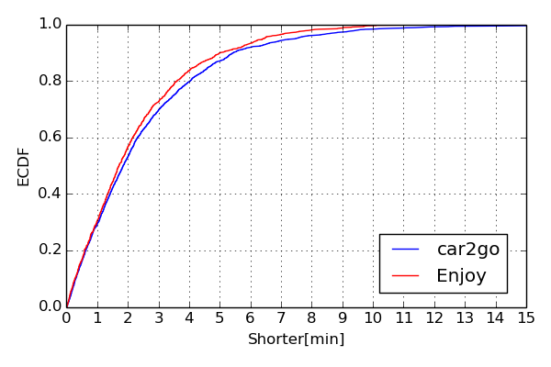
ECDF Rental Time shorter Driving Time
When the Google maps data are available compute the difference between driving duration and the rental duration
Recall: Rental Duration = Reservation Time + Driving Time + Parking Time
Trip with driving duration shorted than rental duration are:
12.0% for car2go
6.5% for Enjoy
50% of the time the trip is shorter it is 2 minutes shorter
Insight
Car2go drivers seems to drive faster than Enjoy drivers

Slide 29
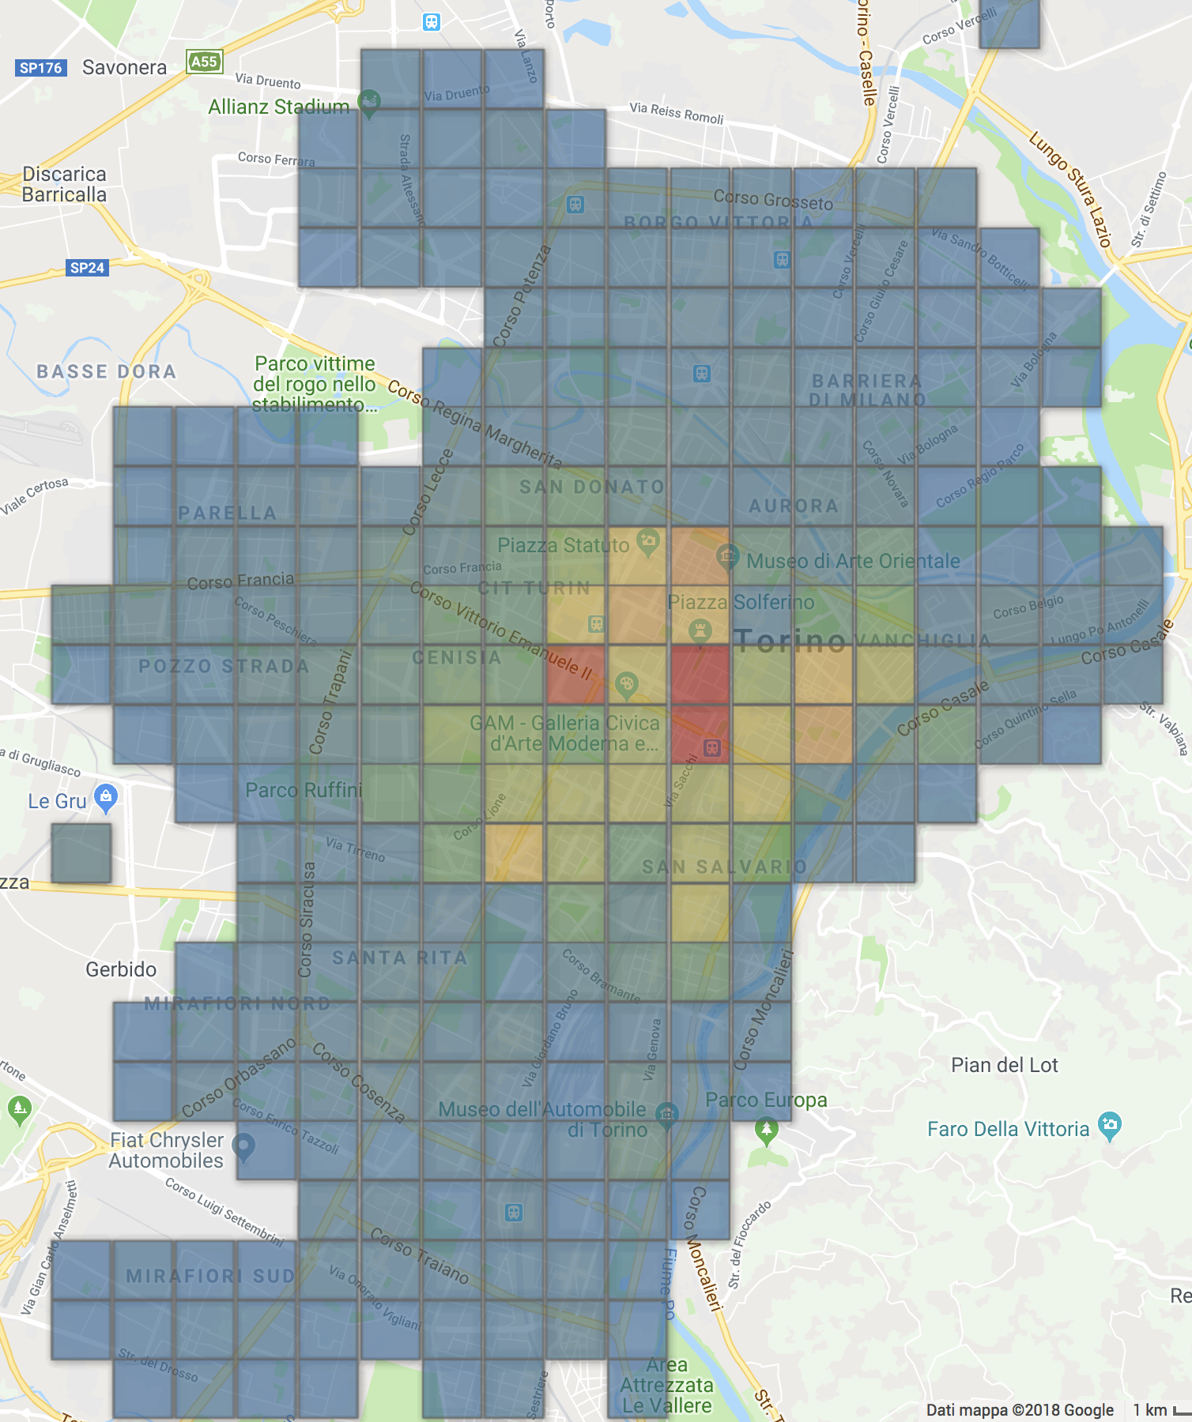
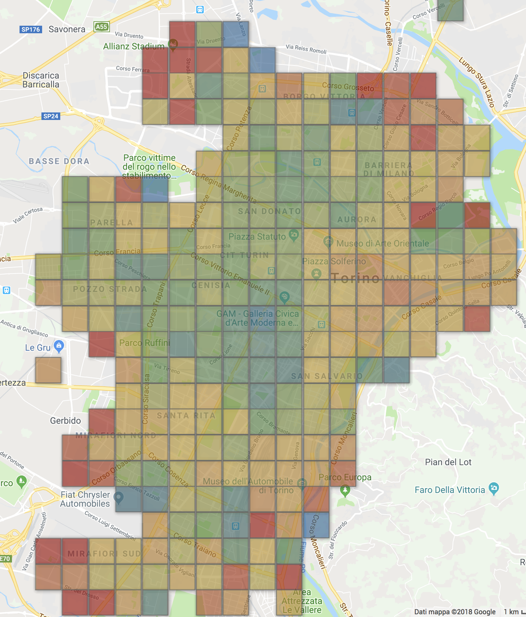
Users’ parking habits
We divide Turin in a grid with square zones of 500 m length
To each zone we compute: Number of parking and Average parking Time
Porta Nuova
(main railway station) 47.15 rentals/day
Periphery,
0.017rentals/day
1 parking lasted 31 h
Number of parking
Average parking time
Notes:
mettere scale ad heatmap (km e colori)
numero parking al giorno
valori dell'avg sui parcheggi
togliere sum time
meno gialla la avg time
freccie su i dati
domanda: where to place charge stations?

Slide 30
Challenges

Slide 31
Additional material
You can find this presentation, the challenges presentation, and the Python notebook description @
https://github.com/CityChrone/BigDive/tree/master/presentation
All the material is in the GitHub repository
https://github.com/CityChrone/BigDive

